Slide 1




Department of Computer Engineering
Academic Year 2024-25
Case Study: Environmental Domain
Problem: Multiple linear regression comment on Correlation with proper example
Group Members:
Pratul Jagtap – TY-A-46
Pranav Lohar – TY-A-53
Raj More – TY-A-61
Guide:
Dr. Jyoti Wadmare

Slide 2
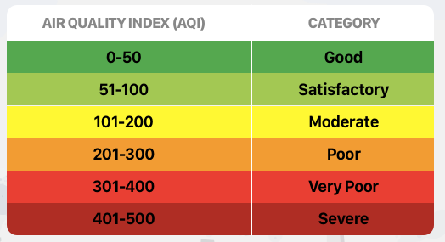
Introduction
What exactly is AQI?
The Air Quality Index (AQI) is a scale used to measure and report the quality of the air in a specific area.
It converts complex air pollution data into a simple, understandable number and color code that tells you how polluted the air currently is or how polluted it is forecast to become.
Air quality levels are grouped into different categories based on how much of certain pollutants are present in the air and how they can affect people's health.

Slide 3

Introduction
Importance of Monitoring AQI:
AQI provides a measure of how safe the air is to breathe. High levels of pollutants can lead to respiratory issues, cardiovascular problems, and other health complications.
Health Monitoring
AQI data helps policymakers enforce regulations, design pollution control strategies, and evaluate the impact of interventions.
Environmental Policy
Helps in identifying pollution hotspots, guiding city development and traffic planning to reduce emissions.
Urban Planning

Slide 4
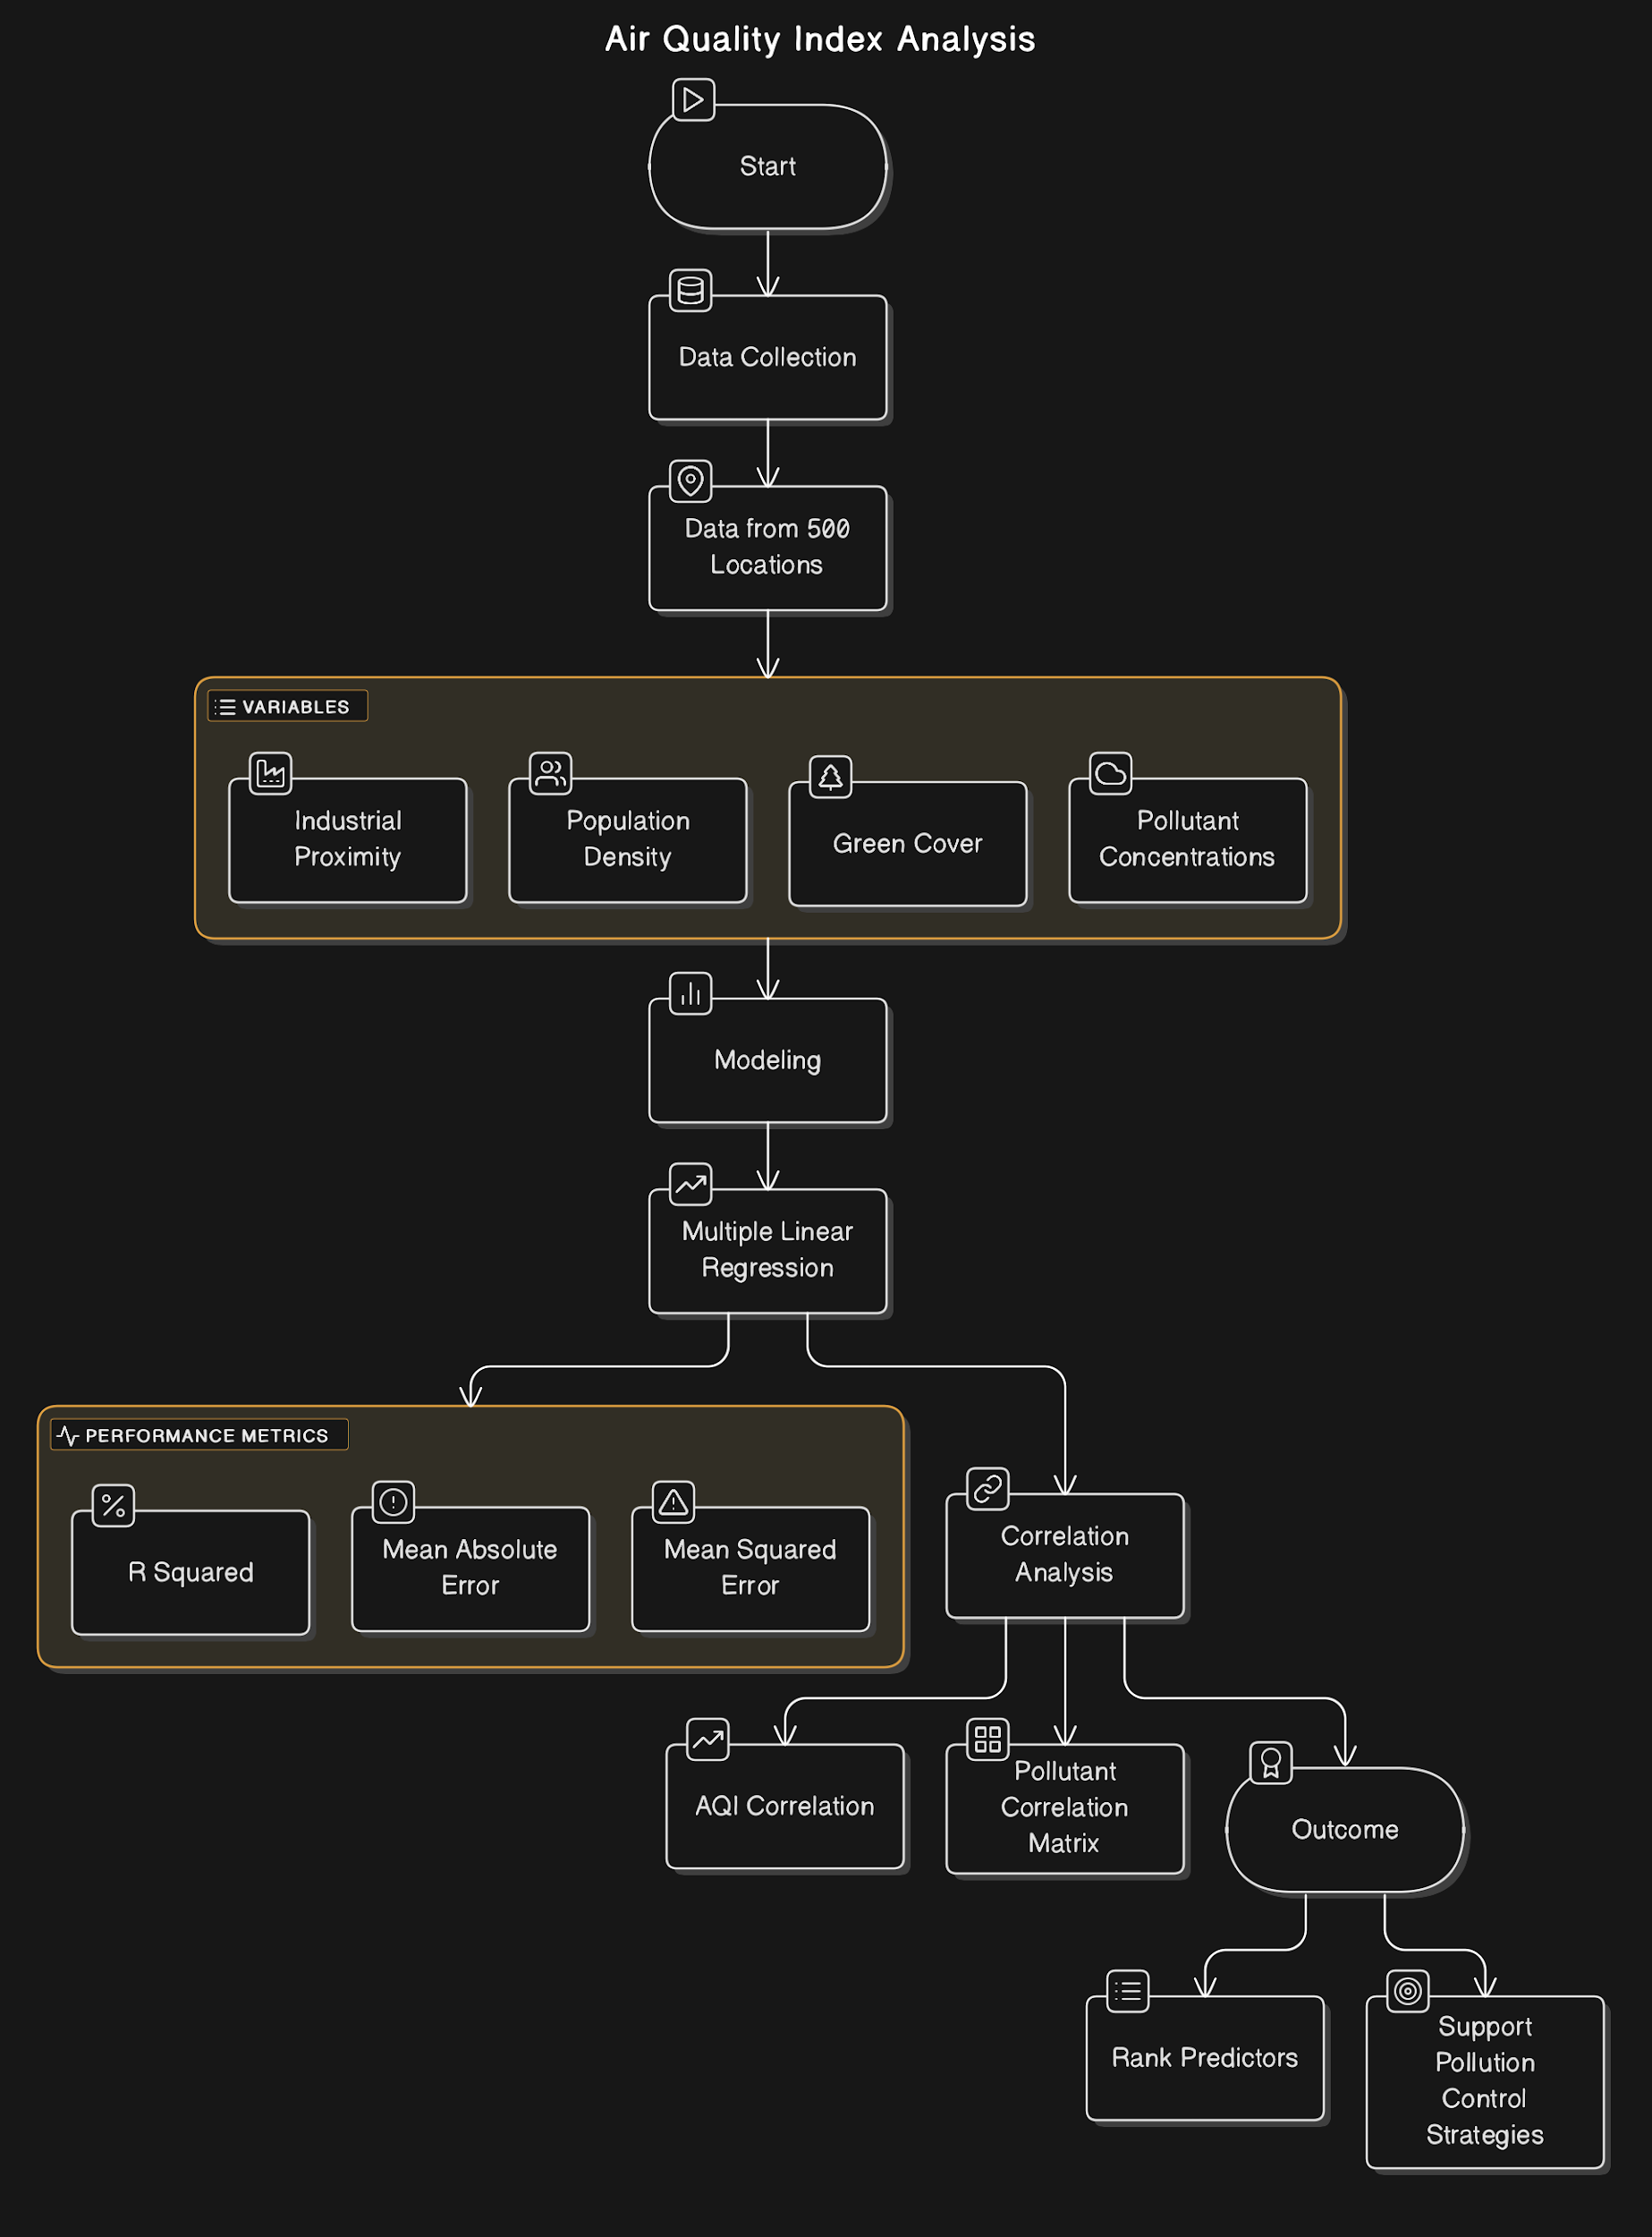
Problem Statement
This case study applies multiple linear regression to evaluate how industrial proximity, population density, green cover, and pollutant concentrations influence Air Quality Index (AQI). Using data from 500 locations, the goal is to identify which variables have the strongest correlation with AQI levels.
1. Modeling: Regression built on environmental and pollutant data; performance measured using R², MAE, and MSE.
2. Correlation Analysis: Includes AQI correlation with key variables and a pollutant correlation matrix (NO₂, SO₂, CO).
3. Outcome: Ranks predictors by impact on AQI to support targeted pollution control strategies.

Slide 5

Proposed Methodology
Methodology:
We apply Multiple Linear Regression (MLR) to study how environmental and socio-economic factors influence AQI. The process involves collecting data on pollutants, population density, industrial proximity, and green cover.
Model performance is evaluated using R² and Correlation Coefficient to determine the strength and significance of each predictor.

Slide 6

Data Processing
Data Collection:
The dataset contains environmental and socio-economic variables collected to analyze their impact on Air Quality Index (AQI). It includes multiple parameters that may or may not influence air pollution levels.
It includes a total of 500 locations, with various parameters like temperature, humidity and pollutant concentration, etc.

Slide 7
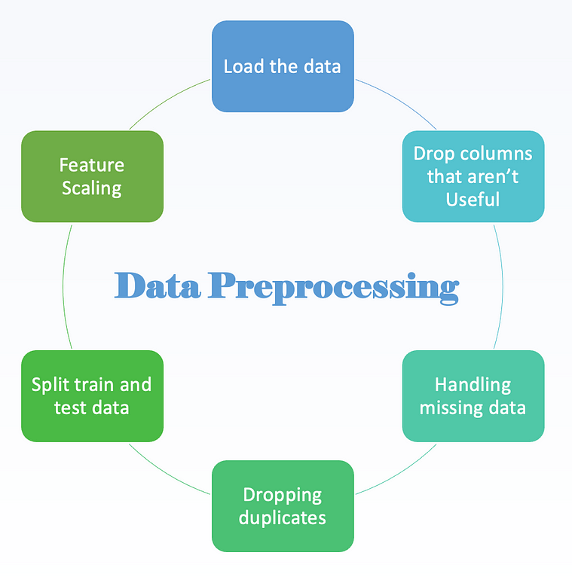
Data Processing
Data Preprocessing:
Due to the large amount of data present, it is important to preprocess the dataset to ensure that outlier/incorrect data do not influence the decision-making capability of the model.
Clean the dataset by eliminating null values, normalizing or replacing outlier data and removing of parameters like latitude and longitude of locations and other features that don’t influence the target variable

Slide 8

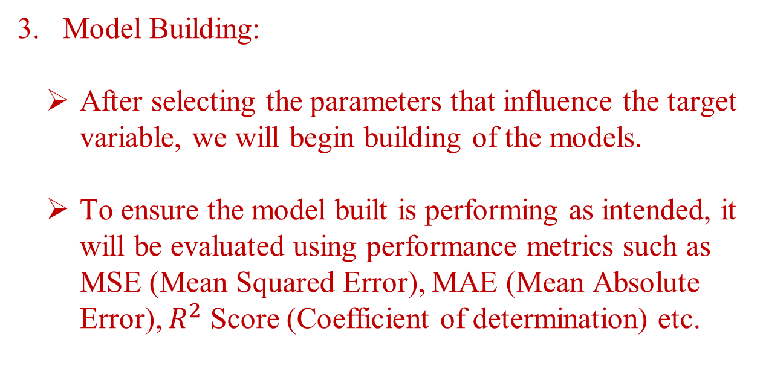
Data Processing

Slide 9
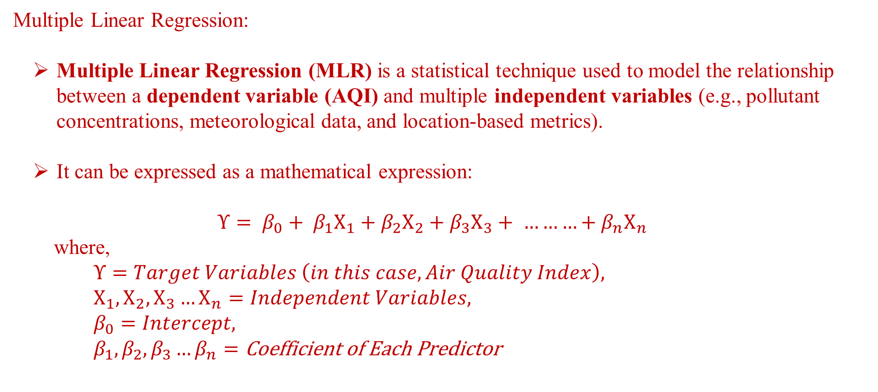
Methodology

Slide 10
Methodology
Correlation:
Correlation measures the strength and direction of a linear relationship between two variables. It helps determine which features are strongly related (positive or negative) to the target variable and which are unrelated to the same.
The Coefficient of Correlation’s value ranges between -1 and 1, where:
+1 | → | Positive Correlation (Target Variable ↑ , Independent Variable ↑)
0 | → | No correlation
-1 | → | Negative Correlation (Target Variable ↑ , Independent Variable ↓)

Slide 11
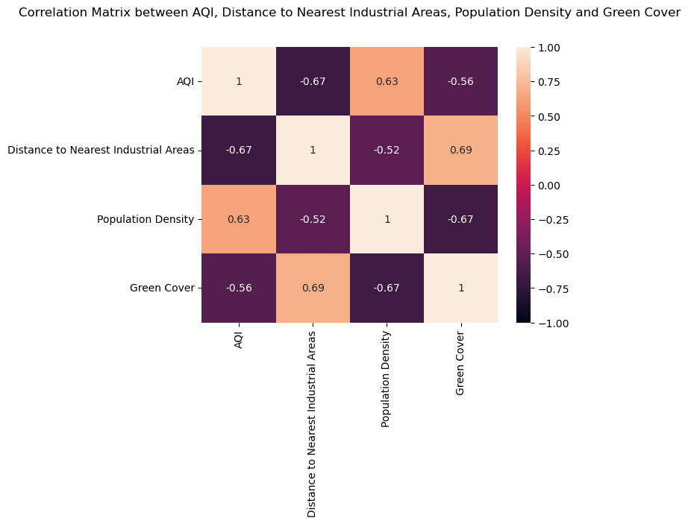
Result

Slide 12
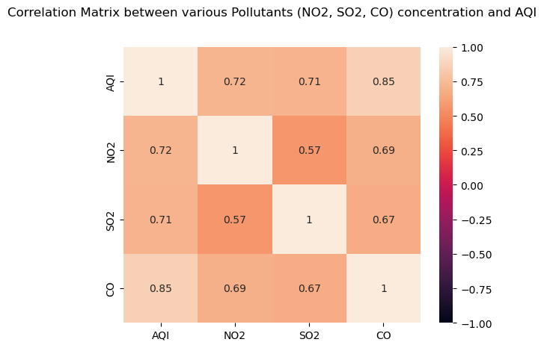
Result

Slide 13
Result
Performance Metrics:
Mean Absolute Error (MAE): 55.4753
Mean Squared Error (MSE): 6032.3804
R2 Score: 0.6762
Feature Coefficients:

Slide 14

Conclusion
The analysis of the AQI dataset using Multiple Linear Regression (MLR) emphasizes the influence of various environmental and demographic predictors on air quality.
Pollutants like NO₂, SO₂, and CO show a strong positive influence on AQI, indicating their direct role in deteriorating air quality. In contrast, features like Green Cover are negatively correlated, demonstrating a protective impact.
The MLR model captures the linear relationships among predictors and AQI, providing a clear interpretation of how each factor affects air quality.

